Slide 1













Web-PortFolio
Presentation

Slide 2




Design Logo

Slide 3








Design Icon

Slide 4


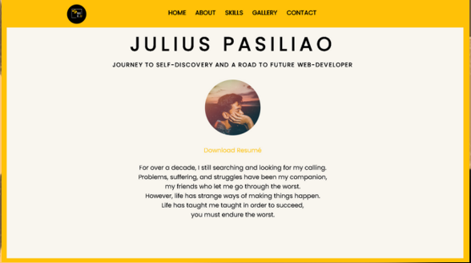

PORTFOLIO INSPIRATION

Slide 5

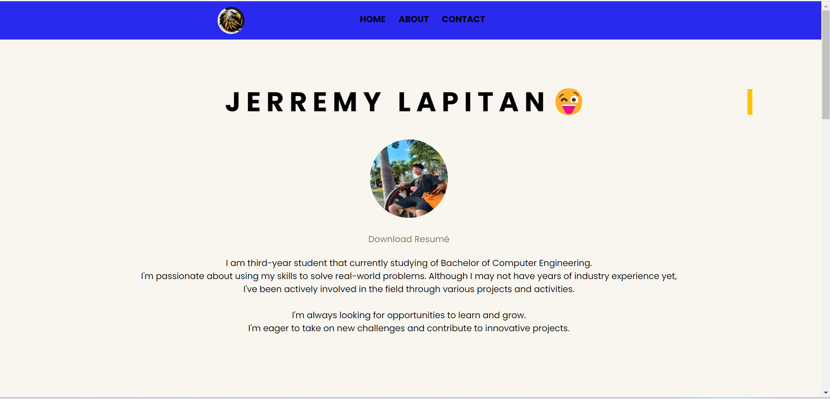

HOME

Slide 6


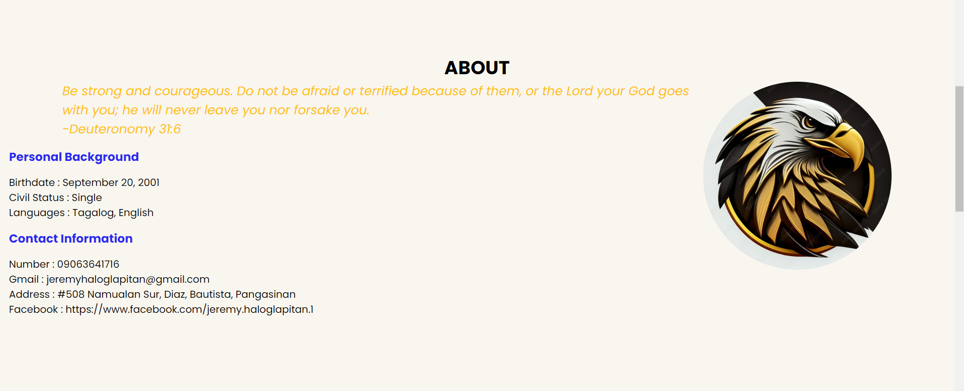

BODY

Slide 7

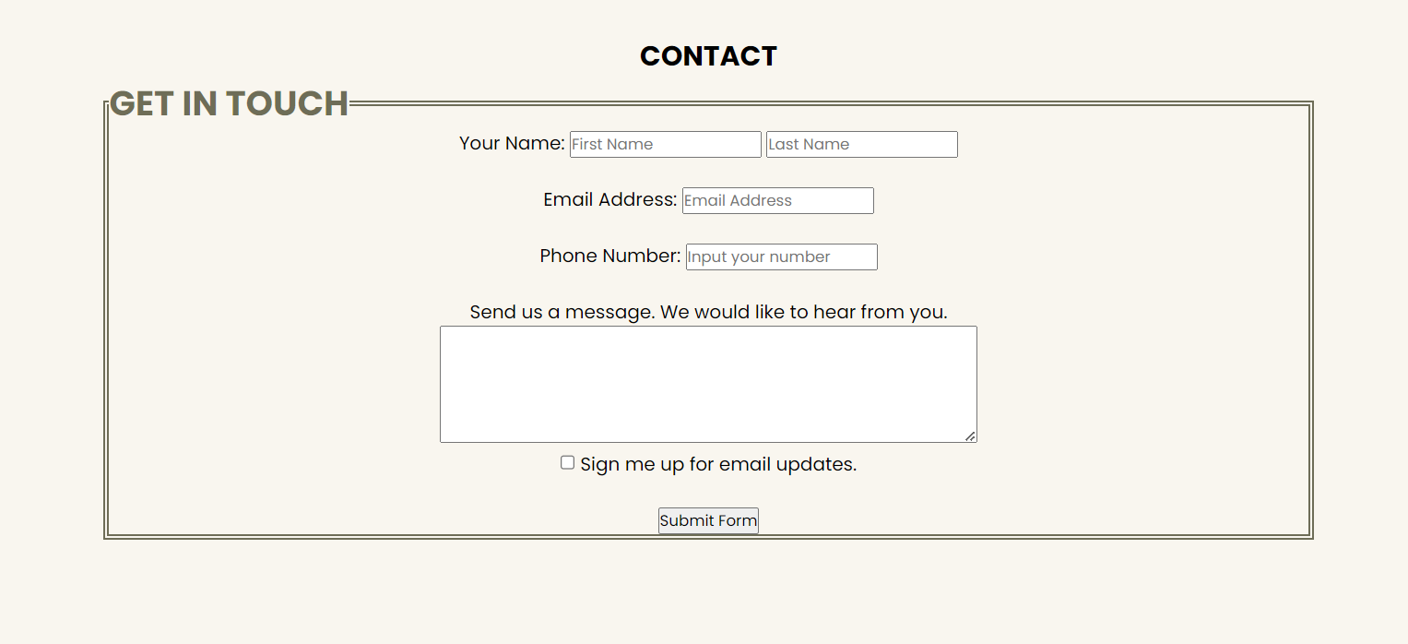


Contact & Footer

